Slide 1
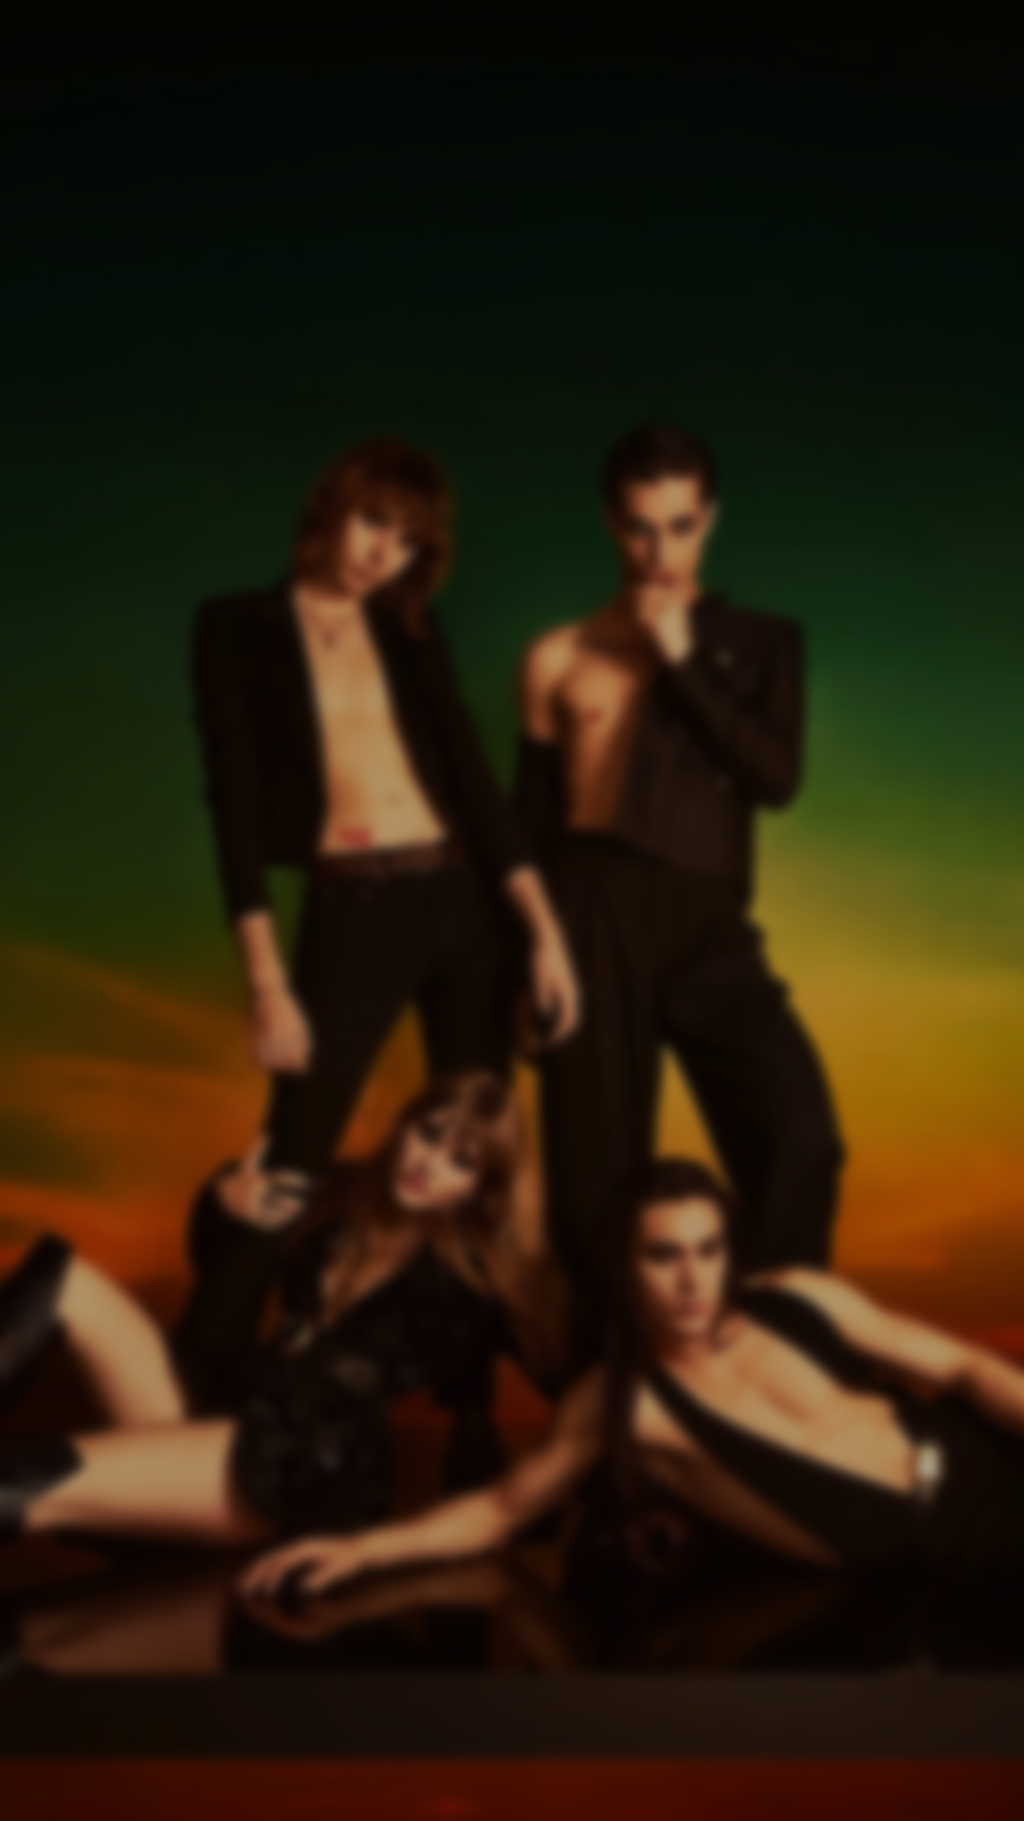

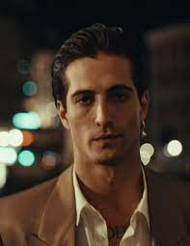
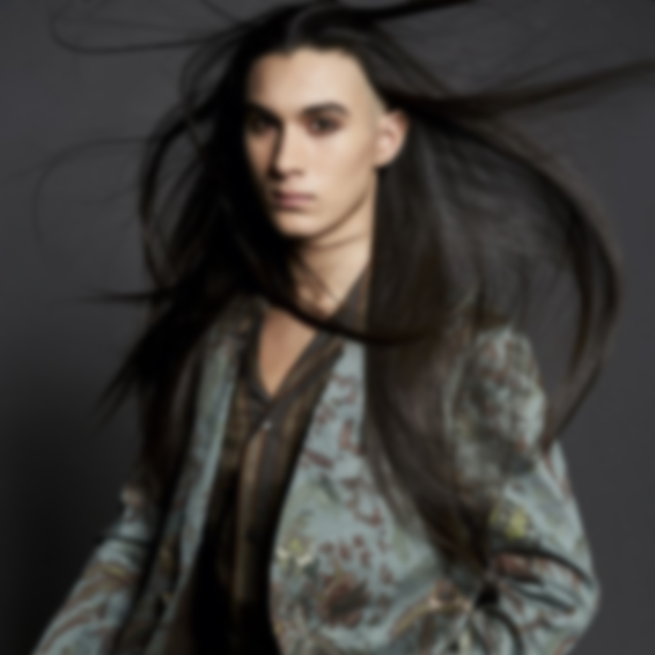
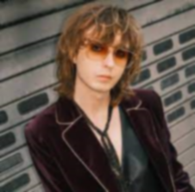
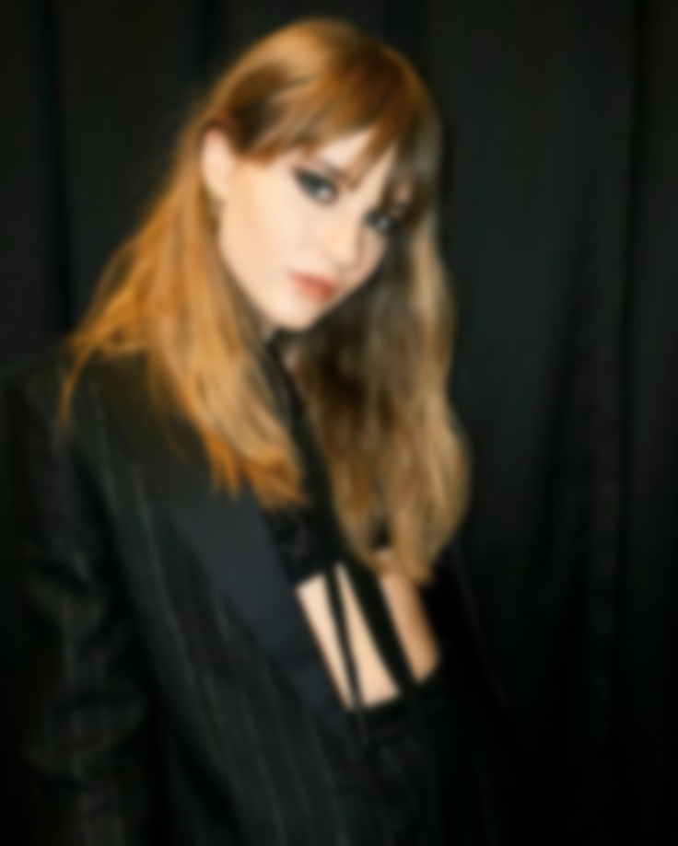
Damiano David
Born 8 January 1999 Rome, Italy.
Occupation(s) Singersongwriter.
Member of Måneskin.

Slide 2



Ethan Torchio
Born October 8, 2000 in Rome Italy.
Occupation(s) Drummer .
Member of Måneskin.

Slide 3

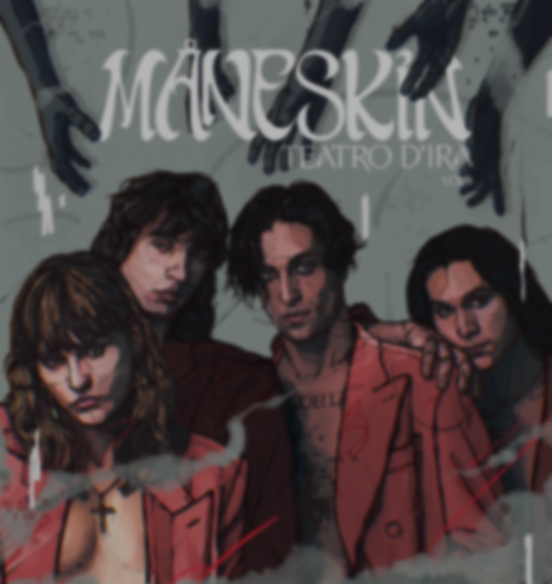

Thomas Raji
Born January 18 2001 in Rome Italy.
Occupation(s) bass guitar composer.
Member of Måneskin.

Slide 4
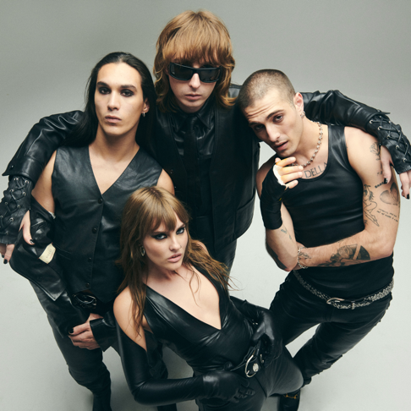

Victoria De Angelis
Born January 28 2000 in Rome Italy.
Occupation(s) electric bass guitar.
Member of Måneskin.

Slide 5
MÅNESKIN

